Slide 1
People do mining … for centuries!

Slide 2
People use computers … for decades!
U.S. Department of Energy uses Intel Supercomputer at Argonne National Laboratory. 2015
1938 Z1: World’s first free programmable device, created by Conrad Zuse.
Notes:
http://www.horst-zuse.homepage.t-online.de/z1.html
Z1
Der Rechner Z1 gilt als der erste frei programmierbare Rechner der Welt. Er wurde 1938 fertiggestellt und vollständig aus privaten Mitteln finanziert. Konrad Zuses erster - in den Jahren 1936-1938 - entstandener Rechner Z1 wurde ein Opfer der Bomben des 2. Weltkrieges und mit ihm sämtliche Konstruktionsunterlagen. Im Jahr 1986 entschloß sich Konrad Zuse, den Rechner Z1 nachzubauen. Der Rechner Z1 enthält alle Bausteine eines modernen Computers, wie z.B. Leitwerk, Programmsteuerung, Speicher, Mikrosequenzen, Gleitkommarithmetik.
Konrad Zuse konstruierte die Z1 in der elterlichen Wohnung. Dort wurde ihm dafür das Wohnzimmer von seinen Eltern zur Verfügung gestellt. Um den Rechner Z1 zu bauen, gab Zuse 1936 seine Stelle bei den Henschel Flugzeugwerken auf und richtete die Werkstatt im Wohnzimmer seiner Eltern ein. Die Eltern Zuses waren von dem Vorhaben nicht gerade begeistert, unterstützten ihn aber wo sie konnten.

Slide 3
People do mining … for centuries!
DATA MINING

Slide 4
If data is the new oil …
… metadata are nuggets and brilliants of our age.
Notes:
https://www.quora.com/Who-should-get-credit-for-the-quote-data-is-the-new-oil

Slide 5
Diamonds: beautiful even as raw material
Brilliant: result of expert’s work
Even more exciting in combination with other material
Notes:
OBEN: https://pagewizz.com/edelsteine-1/

Slide 6
Success Factors:
Idea & Vision
Material
Skills / Methods
Tools

Slide 7
Be Careful With Initial Success !!!
It is hard to believe what you can get and which options arise …
Overwhelming Excitement ...
Start new activities …
Professional Management

Slide 8
Think Data Driven!
Idea & Vision
Material
Skills / Methods
Tools
Build a mid-term or better a long-term strategy.
Stay independent of a particular technology or tool. Not the fancy toolset but rather data is what matters most.
After initial success you should slow down and control speed of expansion.
Focus on: maximized accessibility. Google’s goal was to make the data of the internet accessible. You should become your own Google!

Slide 9
Dataset Profiles / Flow Descriptors
Idea & Vision
Material
Skills / Methods
Tools
Our material is metadata:
Data about data : descriptive data, Dublin core metadata model
Derived data : statistics extracted from documents or corpus
Results of ML procedures : extracted structure and learned models
Outcome of Crowd based operations : Wikipedia with its inherent structure, communication logs, access and edit history.

Slide 10
Big Data Processing: e.g., with Hadoop

Slide 11
Big Graph Processing on Hadoop: e.g., with Giraph

Slide 12
Project Name should stand for:
Graphs, Hadoop, and the entire ecosystem …

Slide 13
Semantic Logging
Idea & Vision
Material
Skills / Methods
Tools
Notes:
CSV => Neo4J
https://www.youtube.com/watch?v=Eh_79goBRUk

Slide 14
Data Science Process Model (DSPM)
Idea & Vision
Material
Skills / Methods
Tools

Slide 15
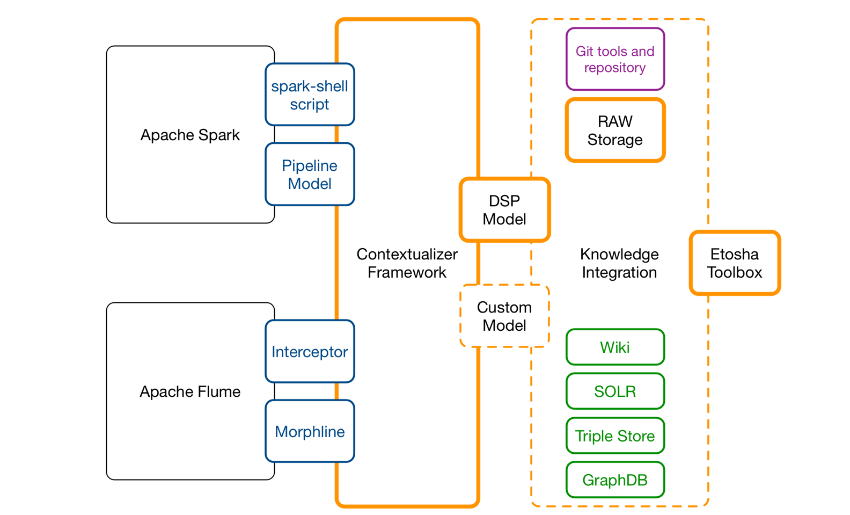
Etosha Toolbox
Idea & Vision
Material
Skills / Methods
Tools
P R O
T O
T
Y
P
E
Data extractors Data transformers
Ontology based orchestration
People and Machines contribute facts
Closed feedback-loops
Iterative approach
Scalable environment
Notes:
There are two key characteristics of RDF stores (aka triple stores): the first and by far the most relevant is that they represent, store and query data as a graph. The second is that they are semantic, which is a rather pompous way of saying that they can store not only data but also explicit descriptions of the meaning of that data. The RDF and linked data community often refer to these explicit descriptions as ontologies. In case you’re not familiar with the concept, an ontology is a machine readable description of a domain that typically includes a vocabulary of terms and some specification of how these terms inter-relate, imposing a structure on the data for such domain. This is also known as a schema. In this post both terms schema and ontology will be used interchangeably to refer to these explicitly described semantics.
https://github.com/SciGraph/SciGraph/wiki/Neo4jMapping

Slide 16
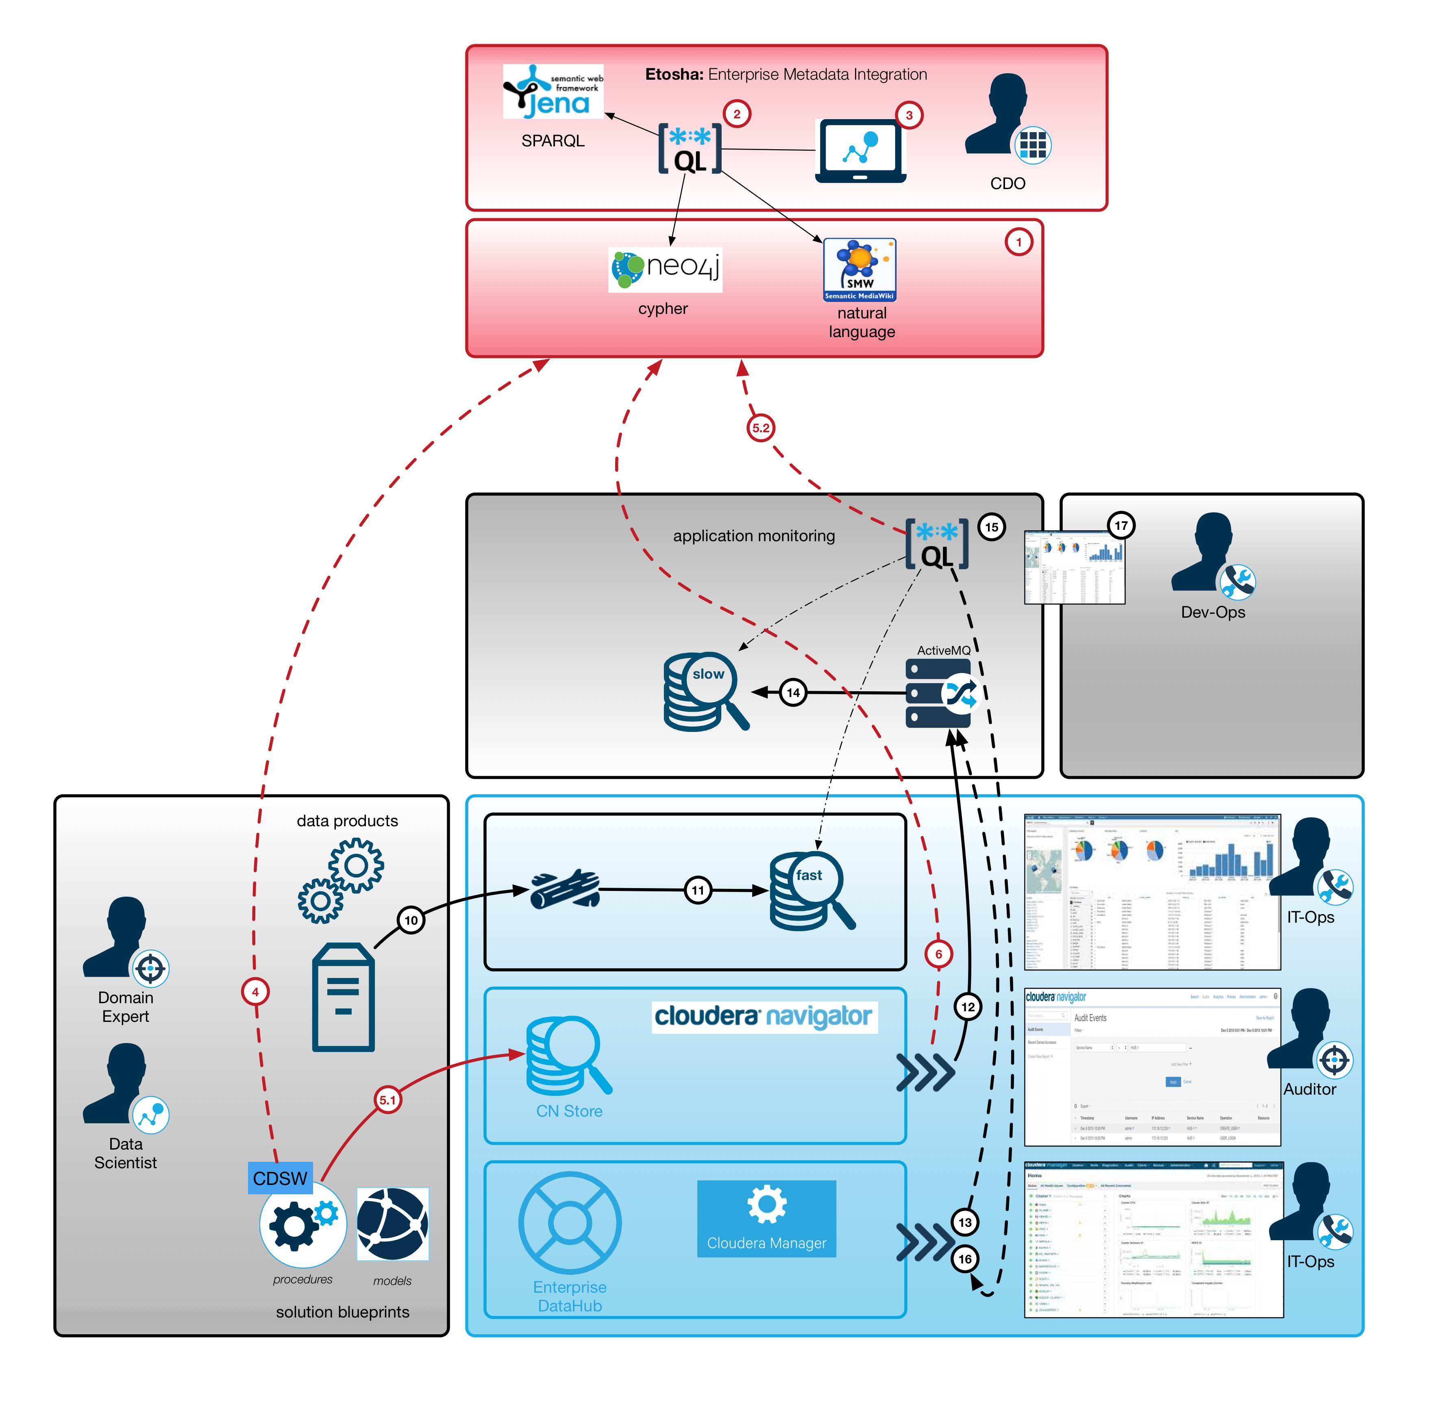
Idea & Vision
Material
Skills / Methods
Tools
I N I T I A L I M P L
E M E N T A T I O N
Multi-layer metadata capturing
Operational metrics Metrics about fast & static data Business metrics
Contextualized presentation Ad-hoc queries Graph-analytics
> Knowledge exposure > Self-Service DS and BI speak the same language.

Slide 17
Results: Access to Facts & Context of Critical Processes

Slide 18
Results: Flexibility and Collaboration

